Slide 1
An introduction to:
Neural Networks

Slide 2
What are Neural Networks?
Models of the brain and nervous system
Highly parallel
  Process information much more like the brain than a serial computer
Learning
Very simple principles
Very complex behaviours
Applications
  As powerful problem solvers
  As biological models

Slide 3
Biological Neural Nets
Pigeons as art experts (Watanabe et al. 1995)
  Experiment:
    Pigeon in Skinner box
    Present paintings of two different artists (e.g. Chagall / Van Gogh)
    Reward for pecking when presented a particular artist (e.g. Van Gogh)

Slide 4
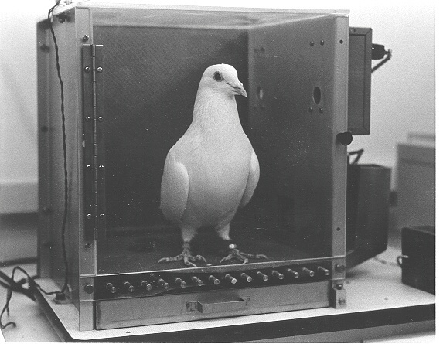

Slide 5
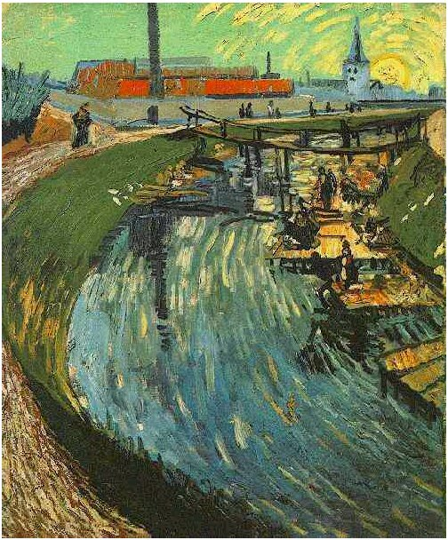
Notes:
Canal with Women Washing, 1888

Slide 6
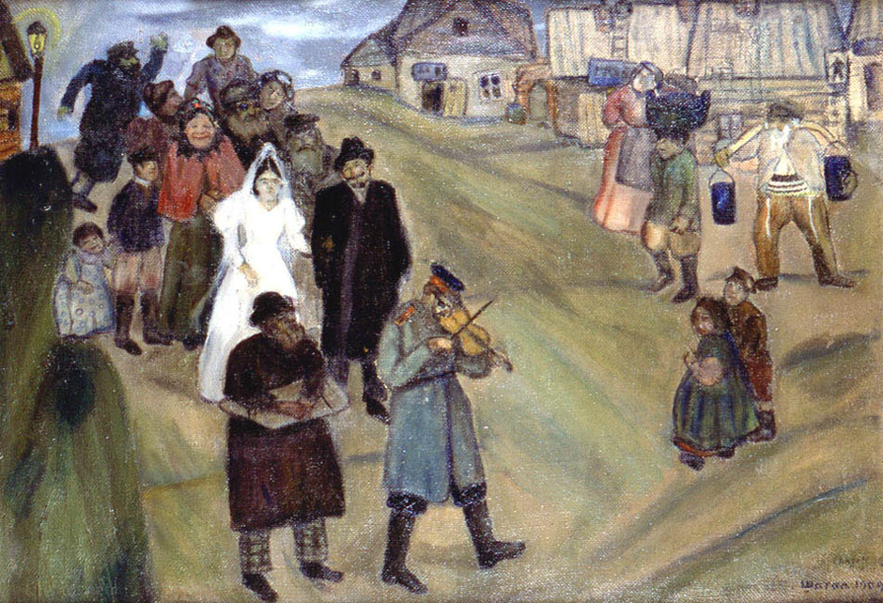

Slide 7
Pigeons were able to discriminate between Van Gogh and Chagall with 95% accuracy (when presented with pictures they had been trained on)
Discrimination still 85% successful for previously unseen paintings of the artists
Pigeons do not simply memorise the pictures
They can extract and recognise patterns (the ‘style’)
They generalise from the already seen to make predictions
This is what neural networks (biological and artificial) are good at (unlike conventional computer)

Slide 8
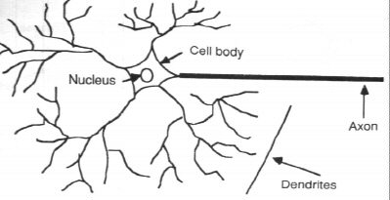
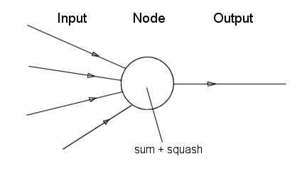
Neurone vs. Node

Slide 9
The First Neural Neural Networks
X₁
2
X₂
2
Y
-1
X₃
The activation of a neuron is binary. That is, the neuron either fires (activation of one) or does not fire (activation of zero).

Slide 10
The First Neural Neural Networks
X₁
2
X₂
2
Y
-1
For the network shown here the activation function for unit Y is
f(y_in) = 1, if y_in >= θ else 0
where y_in is the total input signal received
θ is the threshold for Y
X₃

Slide 11
The First Neural Neural Networks
X₁
2
X₂
2
Y
-1
X₃
Neurons is a McCulloch-Pitts network are connected by directed, weighted paths

Slide 12
The First Neural Neural Networks
X₁
2
X₂
2
Y
-1
X₃
If the weight on a path is positive the path is excitatory, otherwise it is inhibitory

Slide 13
The First Neural Neural Networks
X₁
2
X₂
2
Y
-1
X₃
All excitatory connections into a particular neuron have the same weight, although different weighted connections can be input to different neurons

Slide 14
The First Neural Neural Networks
X₁
2
X₂
2
Y
-1
X₃
Each neuron has a fixed threshold. If the net input into the neuron is greater than the threshold, the neuron fires

Slide 15
The First Neural Neural Networks
X₁
2
X₂
2
Y
-1
X₃
The threshold is set such that any non-zero inhibitory input will prevent the neuron from firing

Slide 16
The First Neural Neural Networks
X₁
2
X₂
2
Y
-1
X₃
It takes one time step for a signal to pass over one connection.

Slide 17

The First Neural Neural Networks
X₁
1
Y
X₂
1
AND Function
Threshold(Y) = 2

Slide 18

The First Neural Neural Networks
X₁
2
Y
X₂
2
AND Function
OR Function
Threshold(Y) = 2

Slide 19

THE FIRST NEURAL NEURAL NETWORKS
Threshold(Y) = 2

Slide 20
The First Neural Neural Networks
X₁
2
Y
X₂
-1
AND NOT Function
Threshold(Y) = 2

Slide 21

The First Neural Neural Networks
2
2
X₁
-1
Z₁
Y
X₂
-1
Z₂
2
2
XOR Function
X₁ XOR X₂ = (X₁ AND NOT X₂) OR (X₂ AND NOT X₁)

Slide 22
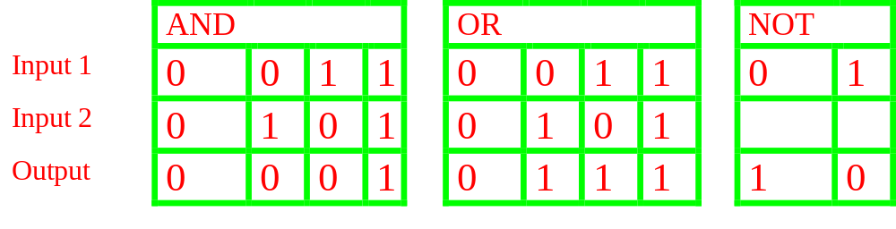
SIMPLE NETWORKS

Slide 23
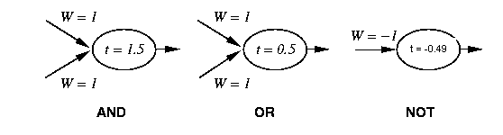
Simple Networks

Slide 24
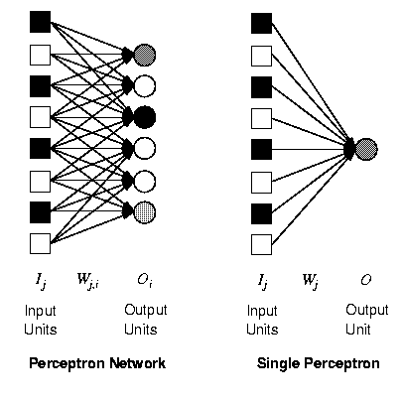
Perceptron
Synonym for Single-Layer, Feed-Forward Network
First Studied in the 50’s
Other networks were known about but the perceptron was the only one capable of learning and thus all research was concentrated in this area

Slide 25
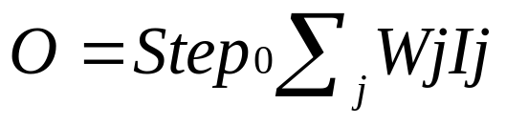
Perceptron
A single weight only affects one output so we can restrict our investigations to a model as shown on the right
Notation can be simpler, i.e.

Slide 26
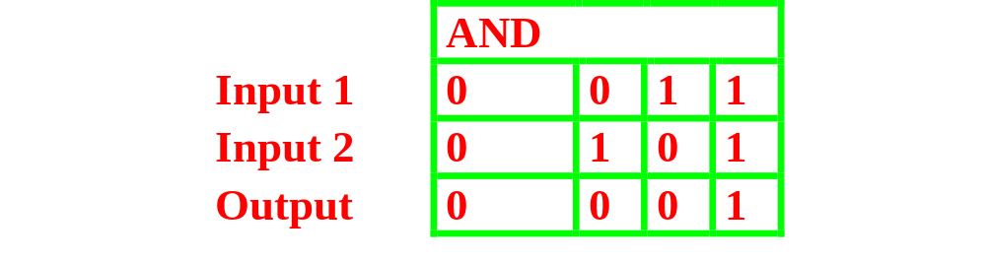
Training a perceptron
Aim

Slide 27
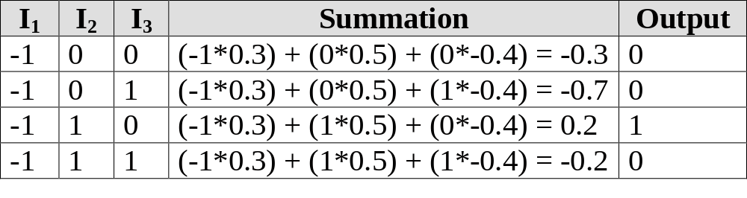
Training a perceptrons
-1
W = 0.3
x
t = 0.0
W = 0.5
W = -0.4
y

Slide 28
Learning
While epoch produces an error
  Present network with next inputs from epoch
  Err = T – O
  If Err <> 0 then
    W_{j} = W_{j} + LR * I_{j} * Err
  End If
End While

Slide 29
Learning
While epoch produces an error
  Present network with next inputs from epoch
  Err = T – O
  If Err <> 0 then
    W_{j} = W_{j} + LR * I_{j} * Err
  End If
End While
Epoch : Presentation of the entire training set to the neural network.
In the case of the AND function an epoch consists of four sets of inputs being presented to the network (i.e. [0,0], [0,1], [1,0], [1,1])

Slide 30
Learning
While epoch produces an error
  Present network with next inputs from epoch
  Err = T – O
  If Err <> 0 then
    W_{j} = W_{j} + LR * I_{j} * Err
  End If
End While
Training Value, T : When we are training a network we not only present it with the input but also with a value that we require the network to produce. For example, if we present the network with [1,1] for the AND function the training value will be 1

Slide 31
Learning
While epoch produces an error
  Present network with next inputs from epoch
  Err = T – O
  If Err <> 0 then
    W_{j} = W_{j} + LR * I_{j} * Err
  End If
End While
Error, Err : The error value is the amount by which the value output by the network differs from the training value. For example, if we required the network to output 0 and it output a 1, then Err = -1

Slide 32
Learning
While epoch produces an error
  Present network with next inputs from epoch
  Err = T – O
  If Err <> 0 then
    W_{j} = W_{j} + LR * I_{j} * Err
  End If
End While
Output from Neuron, O : The output value from the neuron
Ij : Inputs being presented to the neuron
Wj : Weight from input neuron (I_{j}) to the output neuron
LR : The learning rate. This dictates how quickly the network converges. It is set by a matter of experimentation. It is typically 0.1

Slide 33
Learning
I₁
1,1
After First Epoch
0,1
Note
I₁ point = W₀/W₁
I₂ point = W₀/W₂
0,0
1,0
I₂
I₁
1,1
0,1
At Convergence
0,0
1,0
I₂

Slide 34
What can perceptrons represent?
1,1
1,1
0,1
0,1
0,0
1,0
1,0
AND
0,0
XOR
Functions which can be separated in this way are called Linearly Separable
Only linearly Separable functions can be represented by a perceptron

Slide 35
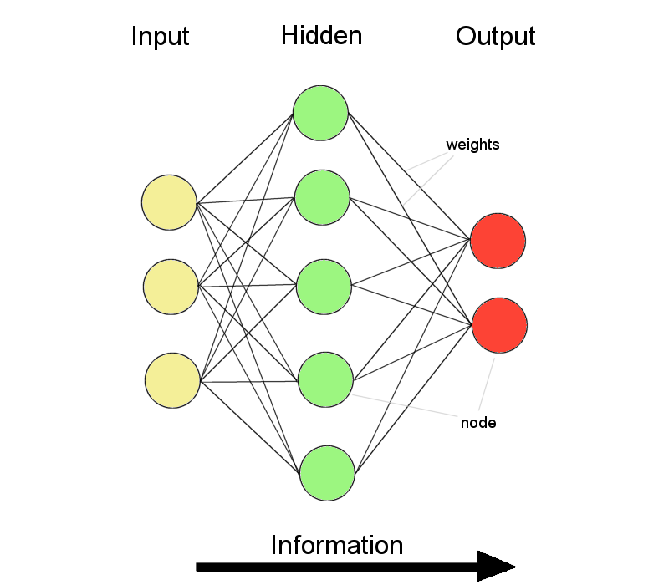
ANNs – The basics
ANNs incorporate the two fundamental components of biological neural nets:
Neurones (nodes)
Synapses (weights)

Slide 36
Feed-forward nets
Information flow is unidirectional
  Data is presented to Input layer
  Passed on to Hidden Layer
  Passed on to Output layer
Information is distributed
Information processing is parallel
Internal representation (interpretation) of data

Slide 37
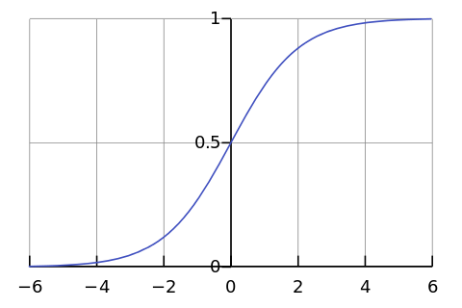

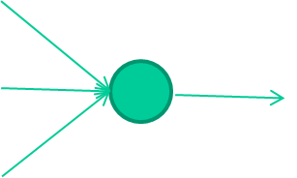
-0.06
W1
W2
f(x)
-2.5
W3
1.4

Slide 38
-0.06
2.7
-8.6
f(x)
-2.5
0.002
x = -0.06×2.7 + 2.5×8.6 + 1.4×0.002 = 21.34
1.4

Slide 39
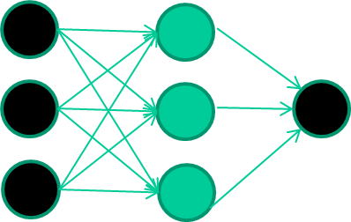
A dataset
Fields class
1.4 2.7 1.9 0
3.8 3.4 3.2 0
6.4 2.8 1.7 1
4.1 0.1 0.2 0
etc …

Slide 40
Training the neural network
Fields class
1.4 2.7 1.9 0
3.8 3.4 3.2 0
6.4 2.8 1.7 1
4.1 0.1 0.2 0
etc …

Slide 41
Training data
Fields class
1.4 2.7 1.9 0
3.8 3.4 3.2 0
6.4 2.8 1.7 1
4.1 0.1 0.2 0
etc …
Initialise with random weights

Slide 42
Training data
Fields class
1.4 2.7 1.9 0
3.8 3.4 3.2 0
6.4 2.8 1.7 1
4.1 0.1 0.2 0
etc …
Present a training pattern
1.4
2.7
1.9

Slide 43
Training data
Fields class
1.4 2.7 1.9 0
3.8 3.4 3.2 0
6.4 2.8 1.7 1
4.1 0.1 0.2 0
etc …
Feed it through to get output
1.4
2.7 0.8
1.9

Slide 44
Training data
Fields class
1.4 2.7 1.9 0
3.8 3.4 3.2 0
6.4 2.8 1.7 1
4.1 0.1 0.2 0
etc …
Compare with target output
1.4
2.7 0.8
0
1.9 error 0.8

Slide 45


Training data
Fields class
1.4 2.7 1.9 0
3.8 3.4 3.2 0
6.4 2.8 1.7 1
4.1 0.1 0.2 0
etc …
Adjust weights based on error
1.4
2.7 0.8
0
1.9 error 0.8

Slide 46
Training data
Fields class
1.4 2.7 1.9 0
3.8 3.4 3.2 0
6.4 2.8 1.7 1
4.1 0.1 0.2 0
etc …
Present a training pattern
6.4
2.8
1.7

Slide 47
Training data
Fields class
1.4 2.7 1.9 0
3.8 3.4 3.2 0
6.4 2.8 1.7 1
4.1 0.1 0.2 0
etc …
Feed it through to get output
6.4
2.8 0.9
1.7

Slide 48
Training data
Fields class
1.4 2.7 1.9 0
3.8 3.4 3.2 0
6.4 2.8 1.7 1
4.1 0.1 0.2 0
etc …
Compare with target output
6.4
2.8 0.9
1
1.7 error -0.1

Slide 49
Training data
Fields class
1.4 2.7 1.9 0
3.8 3.4 3.2 0
6.4 2.8 1.7 1
4.1 0.1 0.2 0
etc …
Adjust weights based on error
6.4
2.8 0.9
1
1.7 error -0.1

Slide 50
Training data
Fields class
1.4 2.7 1.9 0
3.8 3.4 3.2 0
6.4 2.8 1.7 1
4.1 0.1 0.2 0
etc …
And so on ….
6.4
2.8 0.9
1
1.7 error -0.1
Repeat this thousands, maybe millions of times – each time
taking a random training instance, and making slight
weight adjustments
Algorithms for weight adjustment are designed to make
changes that will reduce the error

Slide 51
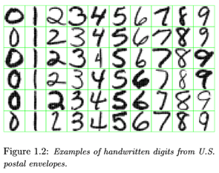
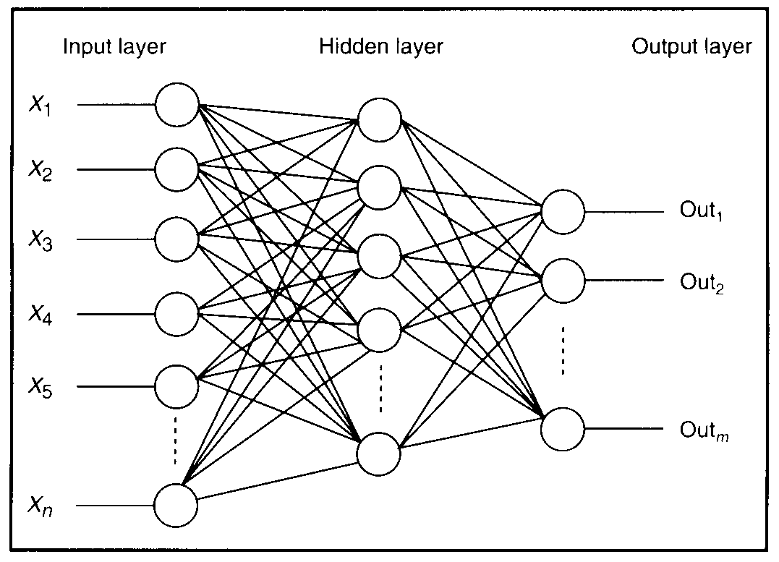

Feature detectors

Slide 52
what is this unit doing?

Slide 53
Hidden layer units become self-organised feature detectors
1 5 10 15 20 25 …
…
1
strong +ve weight
low/zero weight
63

Slide 54
What does this unit detect?
1 5 10 15 20 25 …
…
1
strong +ve weight
low/zero weight
63

Slide 55
What does this unit detect?
1 5 10 15 20 25 …
…
1
strong +ve weight
low/zero weight
it will send strong signal for a horizontal
line in the top row, ignoring everywhere else
63

Slide 56
What does this unit detect?
1 5 10 15 20 25 …
…
1
strong +ve weight
low/zero weight
63

Slide 57
What does this unit detect?
1 5 10 15 20 25 …
…
1
strong +ve weight
low/zero weight
Strong signal for a dark area in the top left
corner
63

Slide 58
What features might you expect a good NN
to learn, when trained with data like this?

Slide 59
vertical lines
1
63

Slide 60
Horizontal lines
1
63

Slide 61
Small circles
1
63

Slide 62
Small circles
1
But what about position invariance ???
our example unit detectors were tied to
specific parts of the image
63

Slide 63
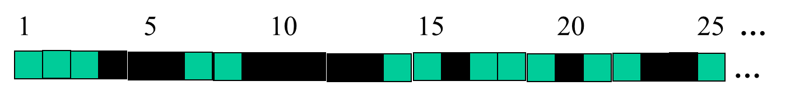
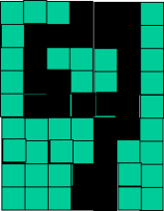
successive layers can learn higher-level features …
detect lines in
Specific positions
etc …
Higher level detetors
( horizontal line,
“RHS vertical lune”
“upper loop”, etc…
etc …
v

Slide 64
successive layers can learn higher-level features …
detect lines in
Specific positions
etc …
Higher level detetors
( horizontal line,
“RHS vertical lune”
“upper loop”, etc…
etc …
v
What does this unit detect?

Slide 65
So: multiple layers make sense

Slide 66
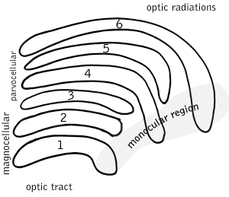
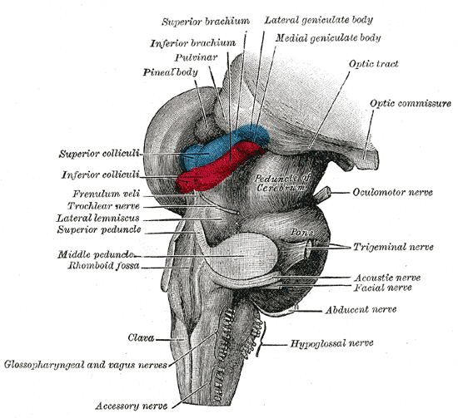
So: multiple layers make sense
Your brain works that way

